Slide 1
CHEVAL CLUB CONDOMINIUM ASSOCIATION
Roof Project: An Update for Owners
Findings of our independent engineering review, and where we stand
Presented by the Board of Directors
Based on the report of Hutchinson Design Group, Ltd. (independent building-envelope consultant), dated June 18, 2026

Slide 2
PURPOSE OF THIS UPDATE
Why we've called this meeting
We want every owner to understand, in plain terms, what is happening with our roof, and to hear it from an independent expert, not just from the parties who did the work.
OUR INDEPENDENT EXPERT
Hutchinson Design Group, Ltd.
Our 2025 roof replacement has developed problems.
Thomas W. Hutchinson, AIA, RRC
Building-envelope consultant with no connection to the design or construction of our roof.
The Board hired an independent engineer to find the facts.
This presentation summarizes what that engineer found.
We'll also explain what the Board is doing to protect the Association.
Roof inspected June 3, 2026 · Report issued June 18, 2026
2

Slide 3
BACKGROUND
How we got here
1
The original problem
With no insulation above the concrete roof deck, interior moisture condensed on the steel and caused wet ceilings, blistered paint, and leaks on the sixth floor. The perimeter masonry also let water in.
2
The Board took action
To fix these long-standing issues, the Board hired Kipcon Great Lakes (the engineer) to design and oversee the work, and Ready Home, Inc. (the contractor) to perform it.
3
The work was done in 2025
The roof was replaced, the rooftop deck reset on pedestals, and masonry repairs undertaken, a major investment by the Association.
4
Then problems appeared
About three months after completion, a roof drain backed up and may have contributed to damaging the new roof. Moisture was later found across much of the roof.
3

Slide 4
GETTING THE FACTS
We brought in an independent expert
Rather than rely only on the engineer and contractor who did the work, the Board retained Hutchinson Design Group to inspect the roof and tell us, independently, whether it was built correctly.
1
2
3
Was it built to the contract?
Was it built correctly?
What caused the damage?
Did the work match what the Association paid for and the specifications called for?
Does the installation meet manufacturer requirements, industry standards, and code?
Is the leaking the result of how the roof was designed and installed?
4

Slide 5
WHAT THE EXPERT CONCLUDED
In short
“The failure of this roof system and masonry restoration project started in design and bidding.”
HDG found that the roof was poorly designed and that this was made worse by poor installation. The new roof already has moisture inside it, which the expert says “indicates a failure,” and the roof “does not meet code.”
DESIGN
Poorly defined; missing drawings & details
INSTALLATION
Not built to spec, manufacturer rules, or code
5

Slide 6
WHAT HDG FOUND · PART 1
Problems with the design & oversight
HDG found the engineer's work fell short of the professional “standard of care,” the level of competence expected in the industry.
No drawings or details were prepared for a complex roof.
No test core was taken, which would have revealed the wet, un-removed old roof.
The specification was changed after bidding, but the project was not re-bid.
No regular on-site inspections were performed during construction.
No written reports, and no interim or final punch lists, were ever produced.
6

Slide 7
WHAT HDG FOUND · PART 2
Problems with the installation
Old roof left in place
Half the insulation
The existing roof was not removed as required, and water was found beneath it.
Only one layer of insulation was installed where two were specified.
Drains not done right
Flashings failing
Drains weren't properly replaced or sealed; one clamping ring had no bolts.
Counterflashing and cant strips were missing; base flashings are coming loose.
Moisture in the roof
Other defects
Test cuts on the west side found wet insulation. The new roof is letting water in.
Open seams, poor penthouse flashing, reused/bent metal, and ill-fitting railings.
7

Slide 8
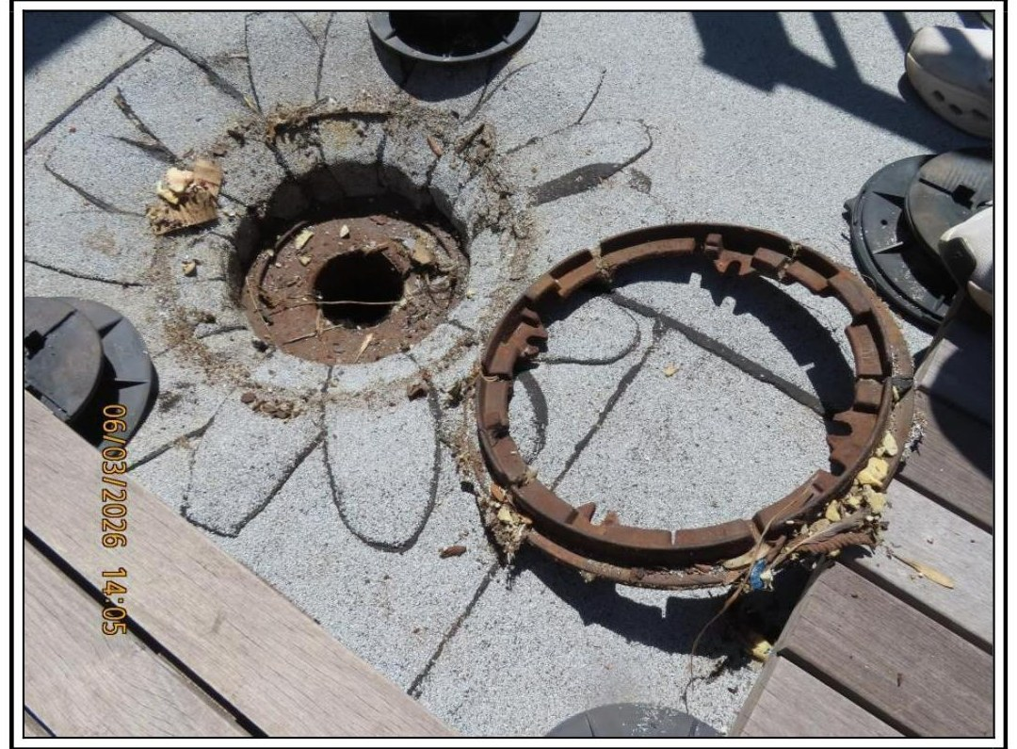
THE DAMAGE WE EXPERIENCED
How water is getting in
On the east side, a roof drain backed up and the trapped water froze and split the new seams. That is one likely pathway, but it may not be the only one.
The expert found the roof is taking on water in more than one place, so the drain backup is one possible cause. Water could also be entering through other defects, such as the flashings or seams.
HDG's key point
Whatever the exact path, the water intrusion points to how the roof was built, not simply to bad weather.
Photo 6 (HDG report): a roof drain clamping ring found with no bolts, so it could not hold the membrane down to keep water out.
8

Slide 9
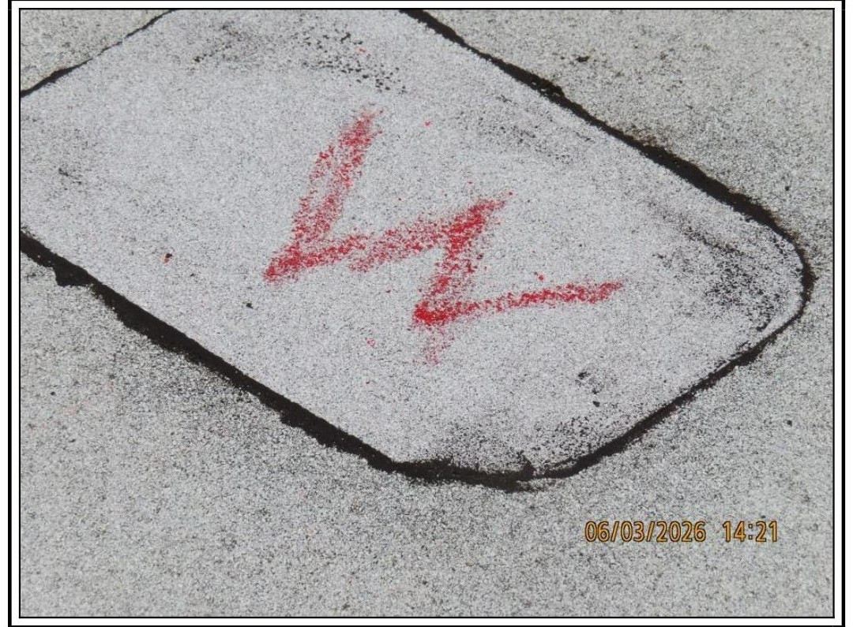
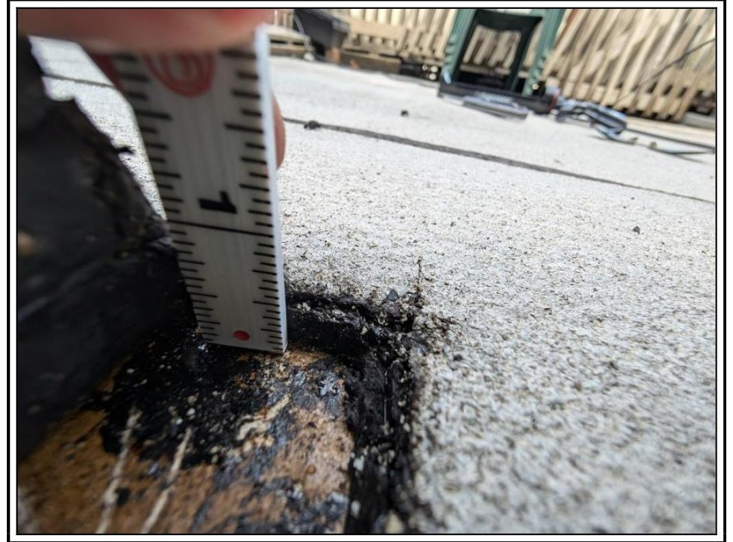
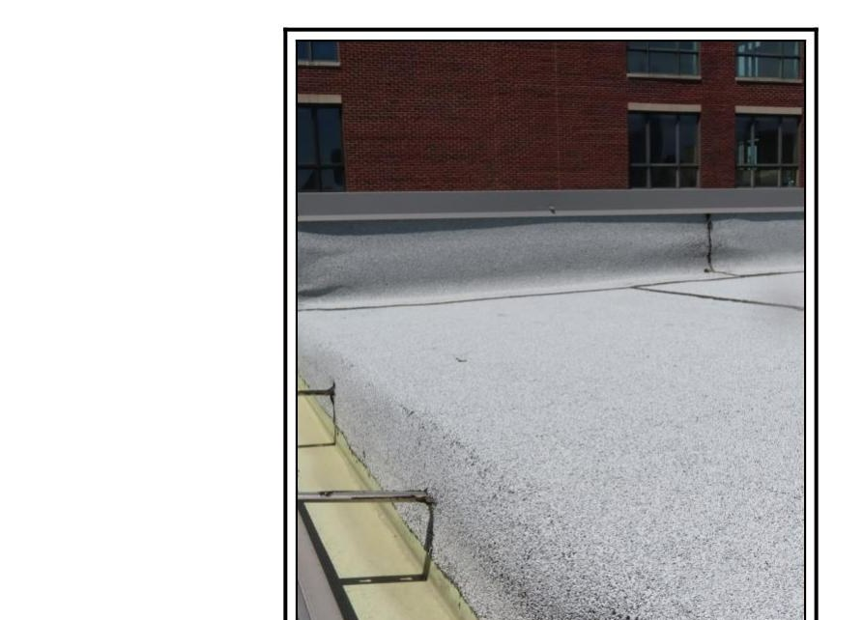
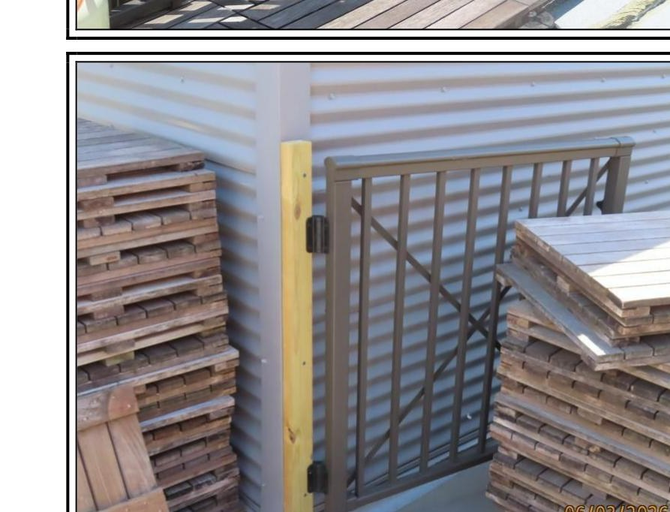
WHAT OUR EXPERT DOCUMENTED · THE ROOF
What HDG saw on the roof
Photo 12: Test cuts on the west side found wet insulation inside the new roof.
Photo 31: A test cut found water sitting on the roof deck.
Photo 14: A gutter that was not removed and is improperly flashed.
Photo 23: New railings that did not reach the wall, bridged with wood.
9

Slide 10
WHAT HDG FOUND · MASONRY
The masonry work, too
The project also included masonry repairs. HDG found important parts of that scope were not performed as specified.
Copings and balustrades were not lifted to install the required new through-wall flashing.
Sixth-floor window lintels were not replaced as specified.
Areas that needed full tuckpointing were only spot-pointed.
Efflorescence, shifting brick, and cracked mortar were observed, all signs of continuing moisture.
10

Slide 11
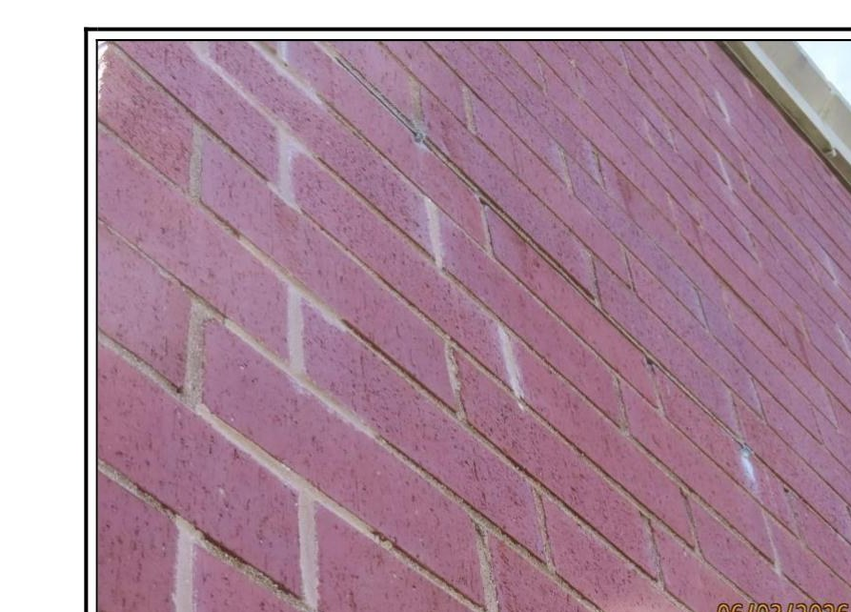
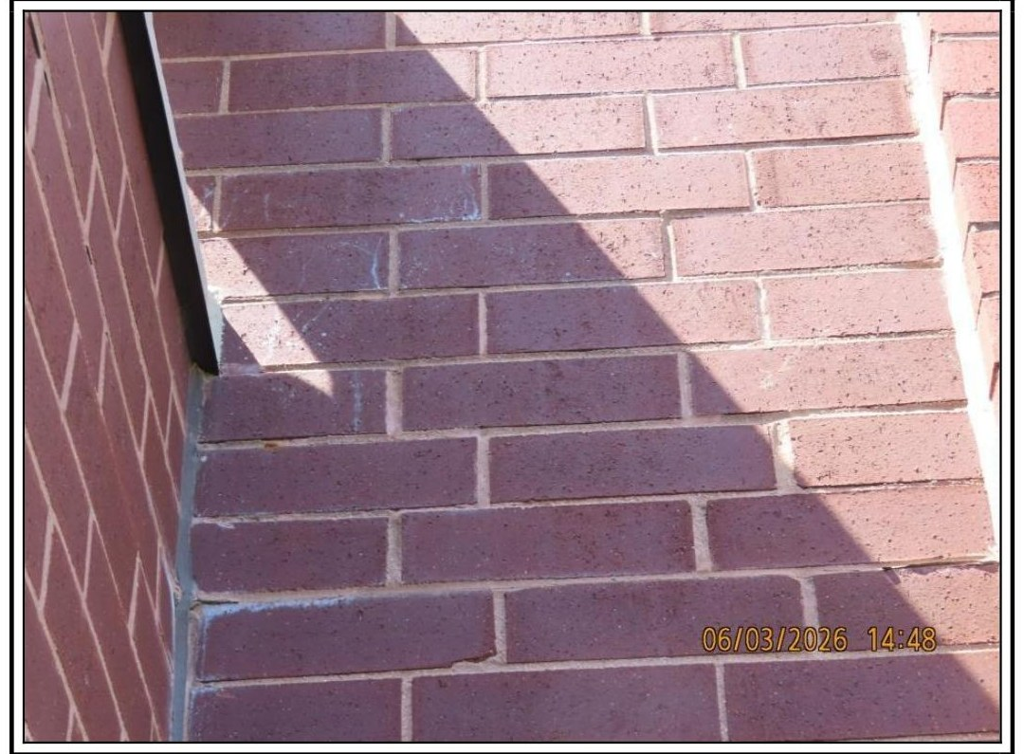
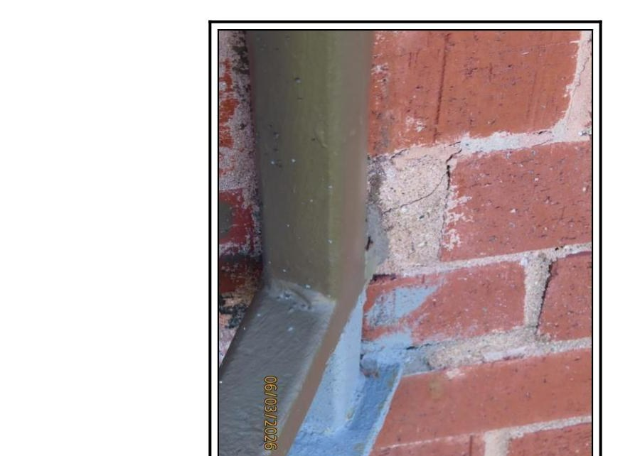
WHAT OUR EXPERT DOCUMENTED · THE MASONRY
What HDG saw in the masonry
Photo 28: A wall that was only spot-pointed, where the brick is now shifting.
Photo 29: Efflorescence and washed-out mortar joints, signs of moisture in the wall.
Photo 30: A steel balcony embedded in the brick that has expanded and cracked the masonry.
11

Slide 12
WHAT THIS MEANS FOR US
What this means for owners
The roof is not performing
We didn't get all we paid for
An independent expert has confirmed the new roof is letting water in and does not meet code.
Significant specified work, on both the roof and the masonry, was not delivered.
Warranty is uncertain
More work lies ahead
We do not yet have confirmation of a valid manufacturer warranty on the new roof.
Further investigation and corrective work will be needed to make the roof right.
12

Slide 13
WHERE WE STAND
What your Board is doing
We obtained the facts from an independent, qualified expert.
We have engaged legal counsel to advise and protect the Association.
We are holding off on final payments while these issues are unresolved.
We are pursuing the parties responsible for the design and the installation.
Our goal is a roof that is properly repaired at the responsible parties' expense, not yours, wherever possible.
13

Slide 14
HOW OWNERS CAN HELP
What we ask of you
Report any interior leaks, stains, or water promptly to the Board.
A note on these findings
Bear with us. Doing this carefully protects everyone's investment.
This summary reflects the independent report of Hutchinson Design Group dated June 18, 2026. The consultant has reserved the right to amend his opinions as more information comes to light.
Bring questions to the Board; we will keep you updated as things progress.
Questions? Speak with any Board member.
Thank you for your patience and trust.
14

